Slide 1
Design Patterns (GOF) and their functional counterparts Paweł Beder
Notes:
What we can do with design patterns in java 8

Slide 2
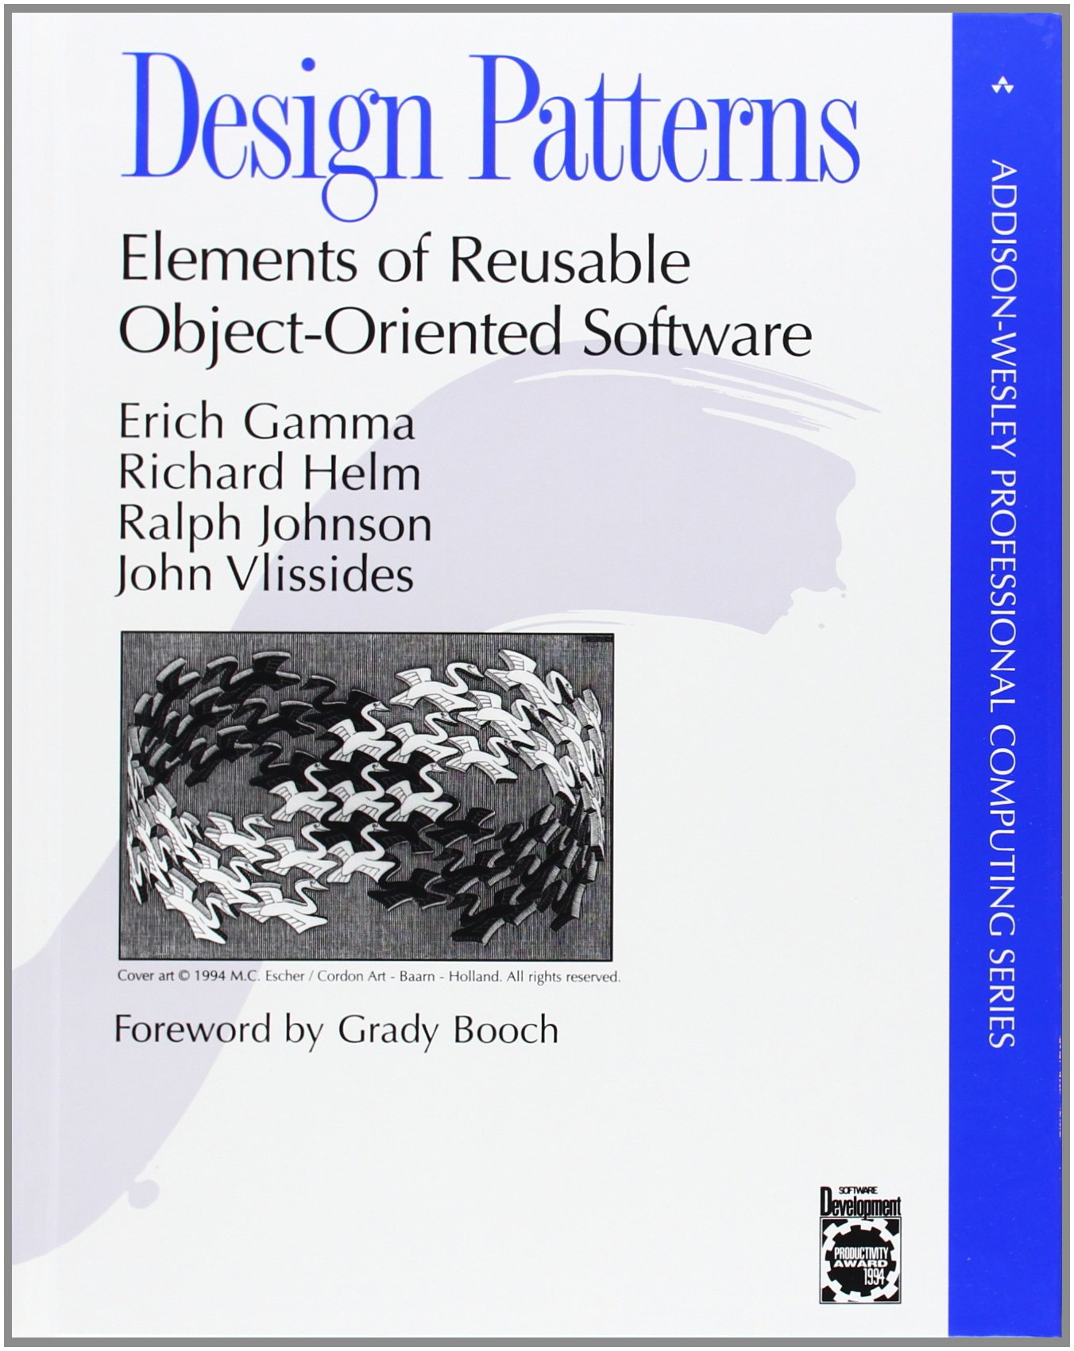
Notes:
Where did those design patterns come from?
31 Oct 1994
Written before Java
Bible of OO Programming
Common Vocabulary
2017 – Functional Programming
Java 8 - 18 March 2014
Who programs in what?

Slide 3
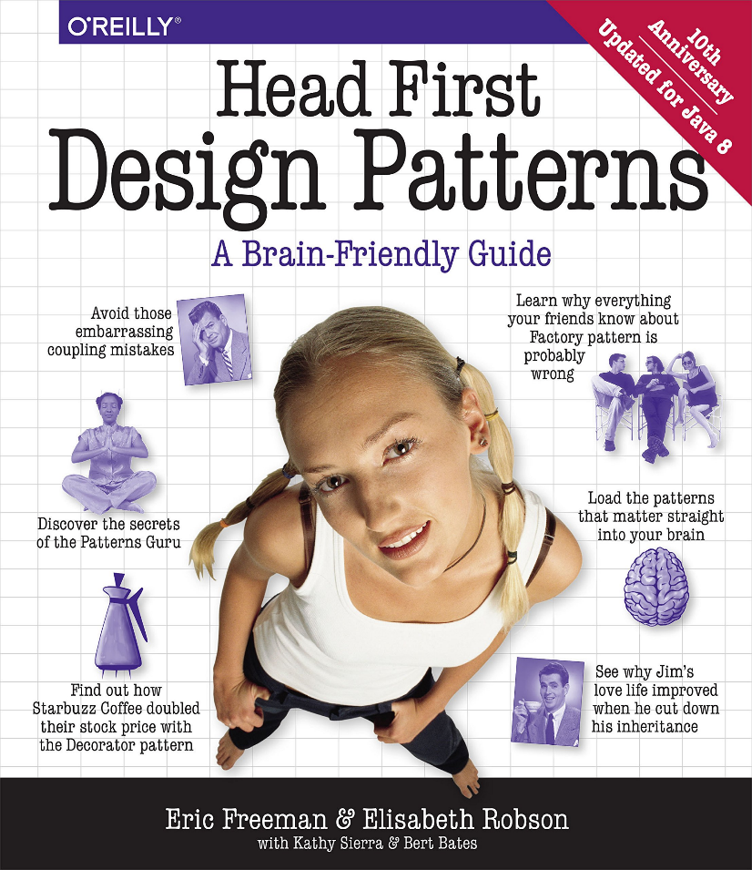
Notes:
More user friendly
Java based
Updated to java8

Slide 4
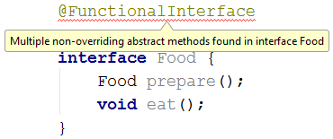
Java 8 Crash Course - @FunctionalInterface
Interfaces with one abstract method (may have other default and static methods)
Lambdas can be used as implementation because there is only one method to implement

Slide 5
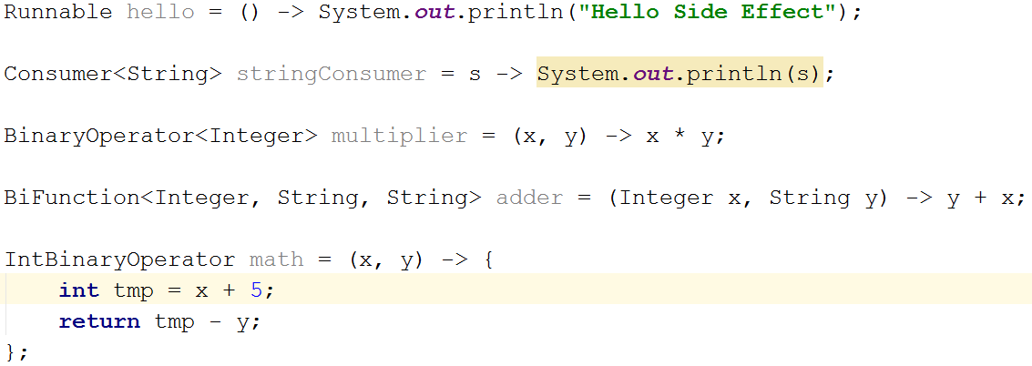
Java 8 Crash Course - Lambdas

Slide 6
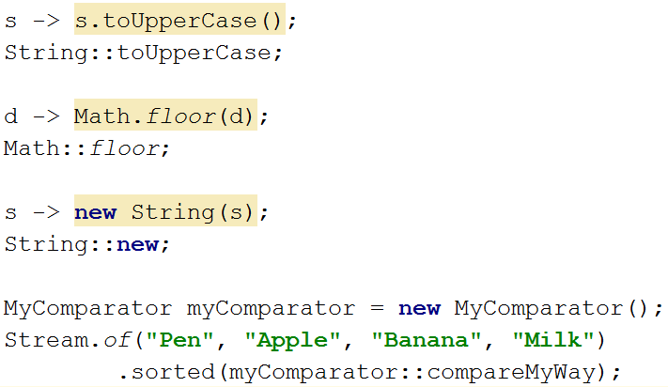
Java 8 Crash Course – Method References

Slide 7
GOF
Creational
Structural
Behavioural
Notes:
Three categories

Slide 8
Creational
Factory
Abstract Factory
Builder
Object Pool
Prototype
Singleton
Notes:
Creational design patterns are concerned with the way of creating objects. These design patterns are used when a decision must be made at the time of instantiation of a class (i.e. creating an object of a class).

Slide 9
Structural
Adapter
Bridge
Composite
Decorator
Facade
Flyweight
Proxy
Notes:
Structural design patterns are concerned with how classes and objects can be composed, to form larger structures.
The structural design patterns simplifies the structure by identifying the relationships.
These patterns focus on, how the classes inherit from each other and how they are composed from other classes.

Slide 10
Behavioral
Chain of Responsibility
Commmand
Interpreter
Iterator
Mediator
Memento
Obesrver
State
Stratety
Template
Visitor
Notes:
Behavioral design patterns are concerned with the interaction and responsibility of objects.
In these design patterns,the interaction between the objects should be in such a way that they can easily talk to each other and still should be loosely coupled.
That means the implementation and the client should be loosely coupled in order to avoid hard coding and dependencies.

Slide 11
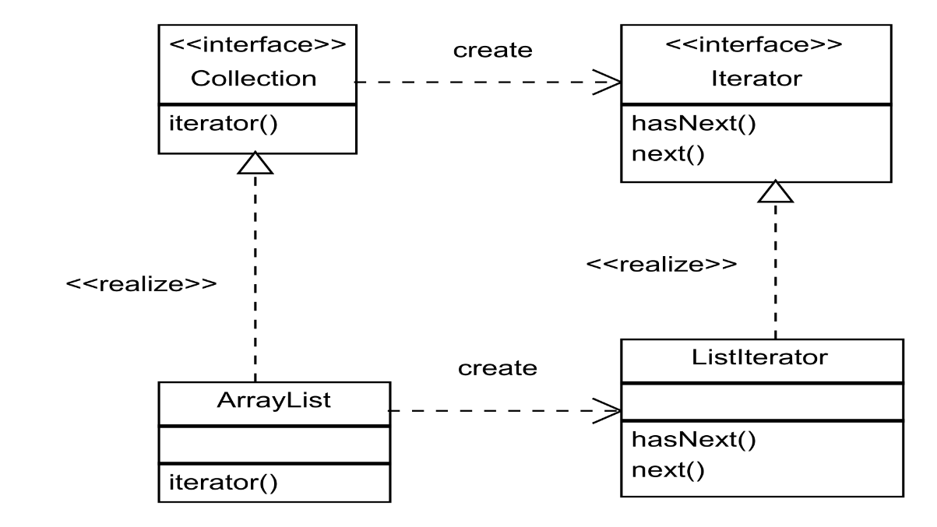
Iterator

Slide 12
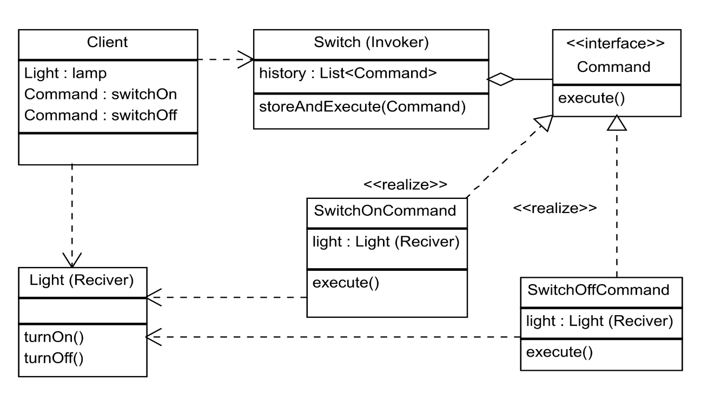
Command
Notes:
Encapsulate reference, method and parameters as an object for later invocation

Slide 13
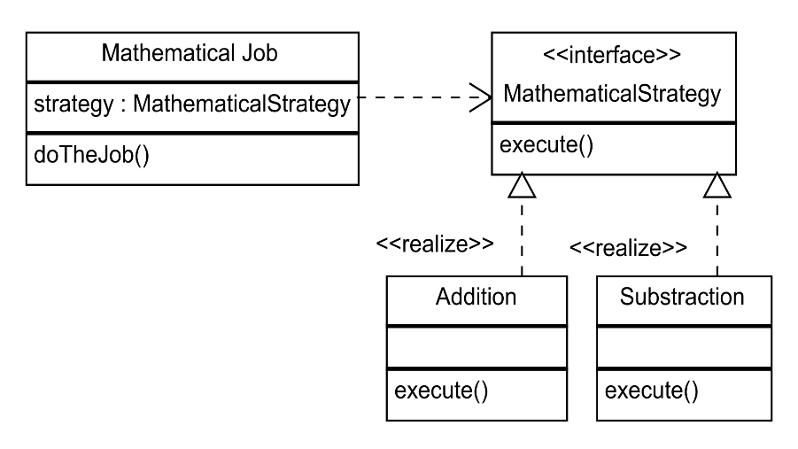
Strategy

Slide 14
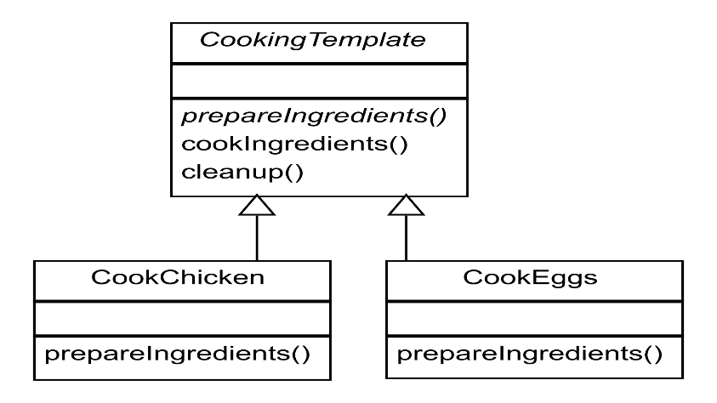
Template

Slide 15
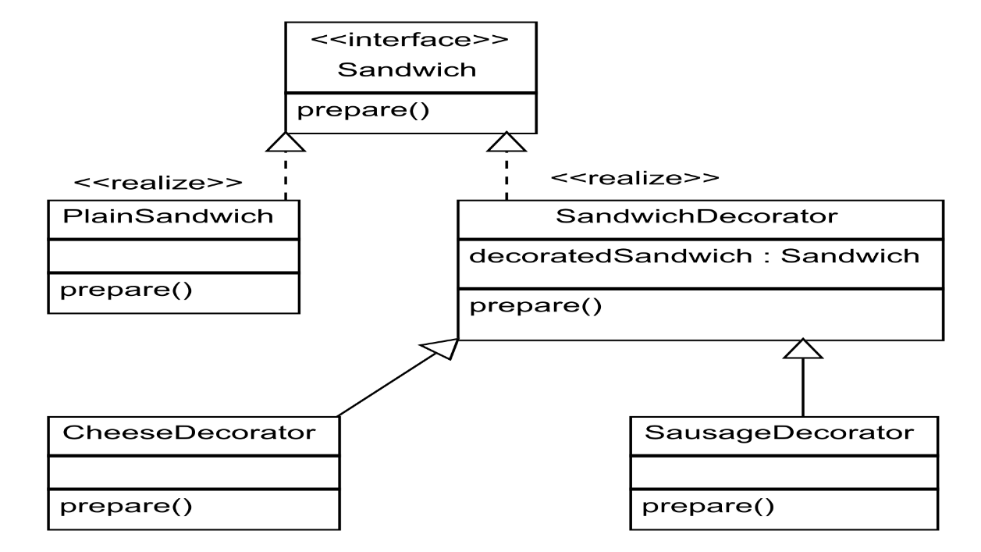
Decorator

Slide 16
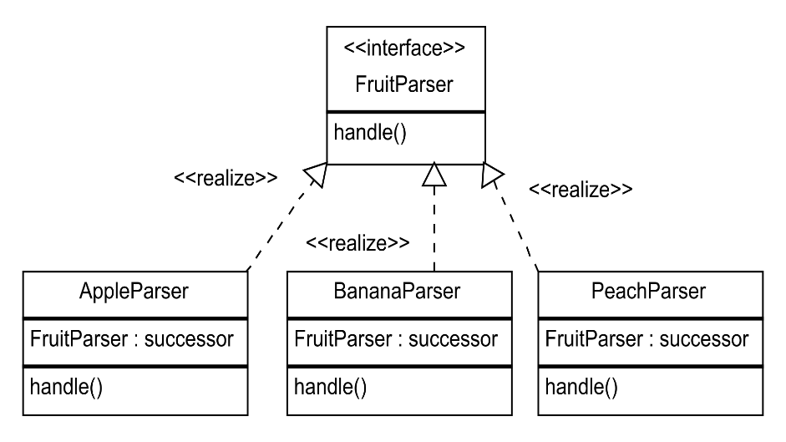
Chain of responsibility

Slide 17
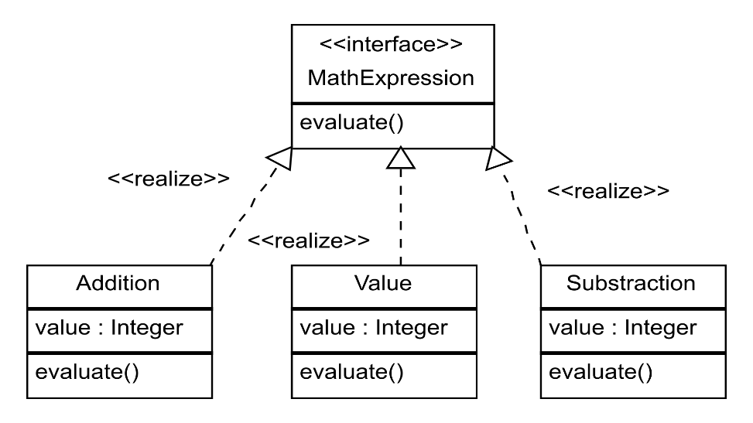
Interpreter

Slide 18
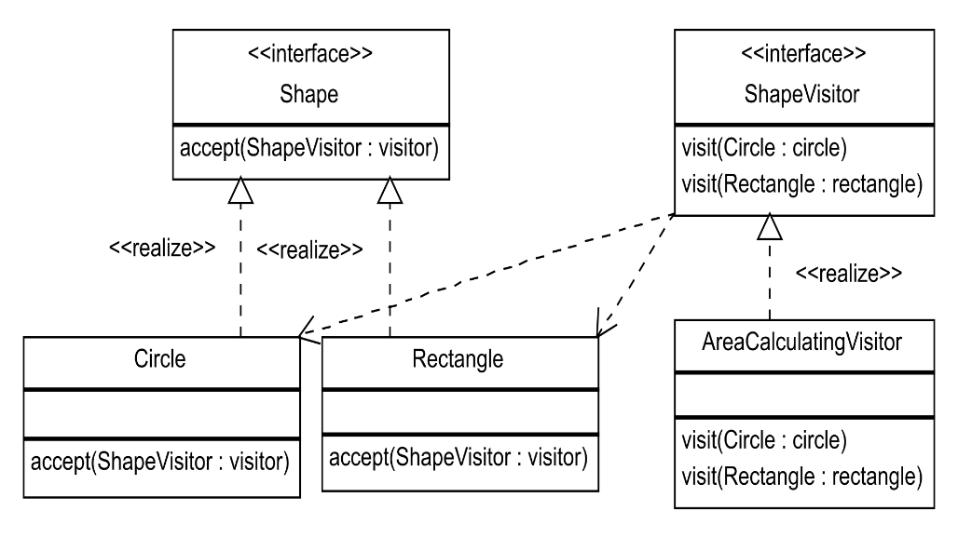
Visitor

Slide 19
Why go functional
It’s 2017 not 90’s
Less boilerplate, less typing
More expressive, readable code
Possibly more performant, immutable, parallel

Slide 20
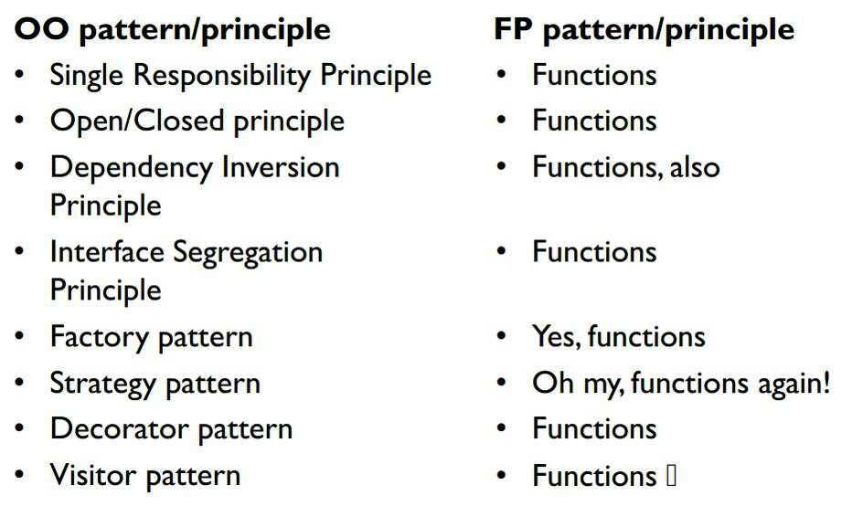
http://blog.cleancoder.com/uncle-bob/2014/11/24/FPvsOO.html

Slide 21
Thank You https://github.com/kinder112/FunctionalPatterns Design Patterns (GOF) and their functional counterparts Paweł Beder

